Slide 1
MOBILE MONEY AND TELCO REGULATION IN NIGERIA
Presented by
MR. MUSA ITOPA JIMOH
HEAD, PAYMENTS SYSTEM POLICY AND OVERSIGHT
CENTRAL BANK OF NIGERIA
AT THE
INTERNATIONAL CONFERENCE ON PAYMENTS SYSTEM 2013
September 16th & 17th 2013

Slide 2
PRESENTATION OUTLINE
Introduction
The Mobile Money Framework
Achievements of The Mobile Money Scheme
Strategy For Growth
Telco Regulation
Challenges facing Mobile Payments Operators
Way Forward
Conclusion

Slide 3
INTRODUCTION
The Access to Financial Services survey conducted by EFInA in 2008 revealed that banking penetration in Nigeria was relatively low
The banking profile of the adult population indicated that:
Only 21% of adult population were banked
74% of the adult population had never been banked
5% previously banked, in other words, had left the banking system

Slide 4
INTRODUCTION
Some of the reasons adduced for not having bank account (financial exclusion) include:
Product complexity (which includes KYC requirement)
Cost of financial service
Distance to financial service outlets

Slide 5
INTRODUCTION
On the other hand, the total mobile phone subscriber base, according to NCC (2009) was slightly over 70m. (Presently over 110m)
Teledensity rose from 0.4% in 2000 to 50% in September 2009
75% of adults living in urban areas and 39% of them living in rural areas have access to a pre-paid mobile phone.

Slide 6
THE MOBILE MONEY FRAMEWORK
Provision of an enabling environment for mobile payments services in providing financial access to unbanked and reducing cash dominance in the Nigerian economy
Specification of minimum technical and business requirements for various participants in the mobile payments services industry in Nigeria
Stipulation of roles and responsibilities of participants in the provision and usage of mobile payments services in Nigeria
Provision of broad guidelines for implementation of all processes and flows of mobile payments transactions from initiation to completion.

Slide 7
THE MOBILE MONEY SCHEME MODELS
The Regulatory Framework identified three (3) major models for the implementation of mobile money scheme; namely:
Bank-Focused Model: This is where a bank delivers banking services to customers using the mobile phone as a delivery channel. This model can only be deployed by licensed deposit-taking financial institutions including Microfinance Banks and Discount Houses.
Bank-Led Model: This is where a bank or consortium of banks, partnering with other organizations, jointly seek to deliver banking services by leveraging on the mobile banking system. This model is applicable only in a scenario where there exists collaboration between a licensed deposit-money bank(s) and an organization duly verified by the partner bank(s)

Slide 8
THE MOBILE MONEY SCHEME MODELS
Non-Bank-Led Model: The model allows a corporate organization that has been duly approved by the CBN to deliver mobile payments services to consumers. The model is applicable to any organization other than a licensed deposit money bank and telecommunication companies.

Slide 9
ACHIEVEMENT OF THE MOBILE MONEY SCHEME
With the licensing of 18 Mobile Money Operators thus far, the mobile money space has witnessed a lot of revolution.
Since commencement of operations in 2012, their overall performance is as given below:
Total number of Subscribers - 9,989,297
Total number of Agents enrolled - 67,494
Total volume of Transactions - over 11m
Total value of Transactions - over N105bn
Product offerings: Cash-In, Cash-Out, Bill payments, Funds Transfer, Airtime etc.

Slide 10
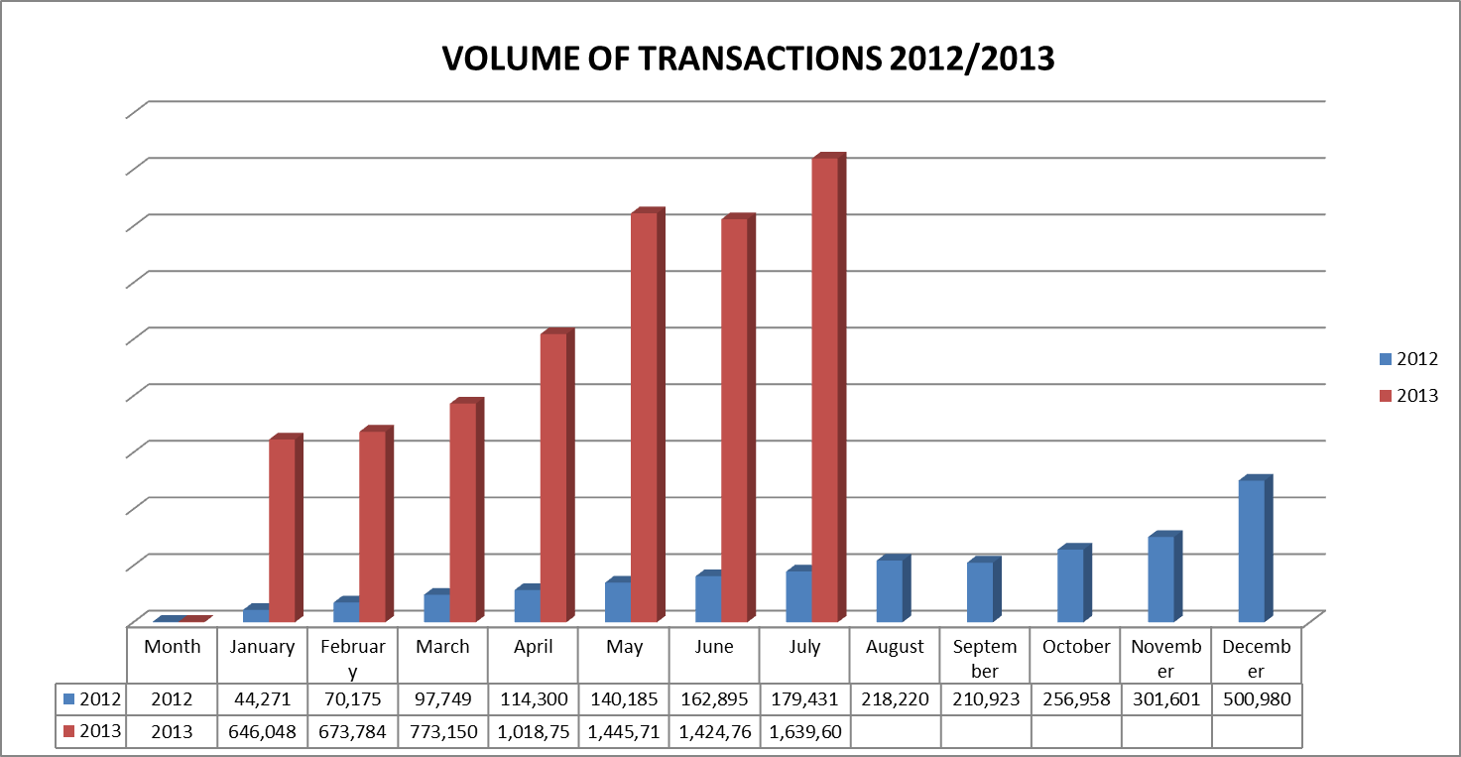
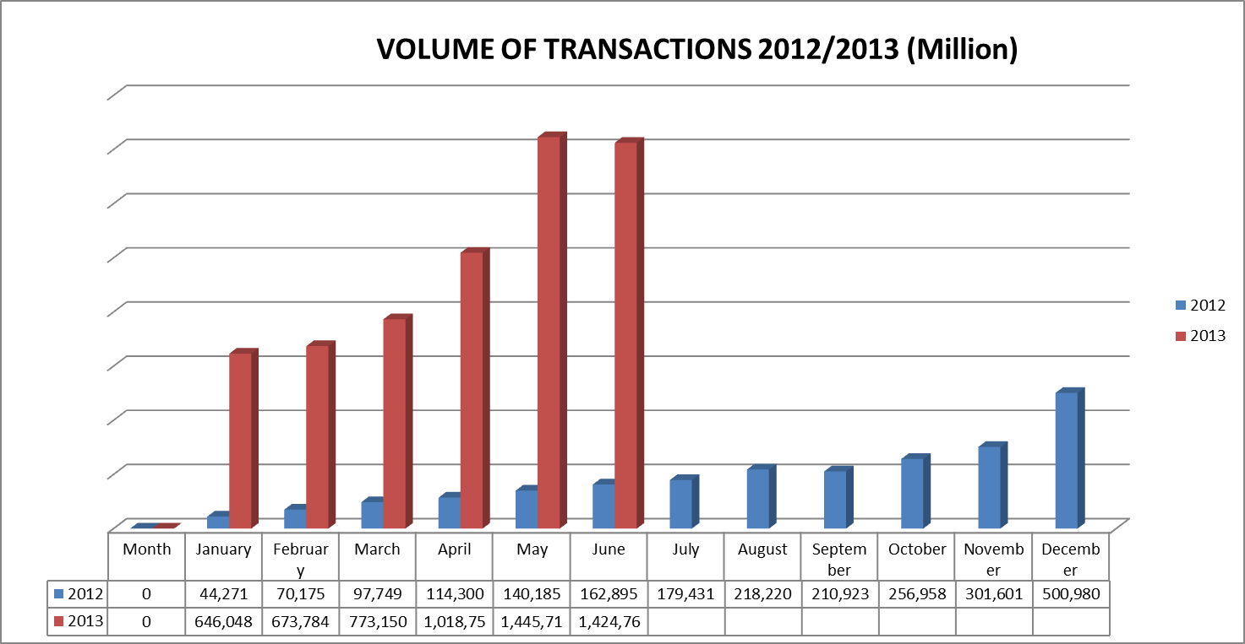
PERFORMANCE OF MMO ACTIVITIES

Slide 11
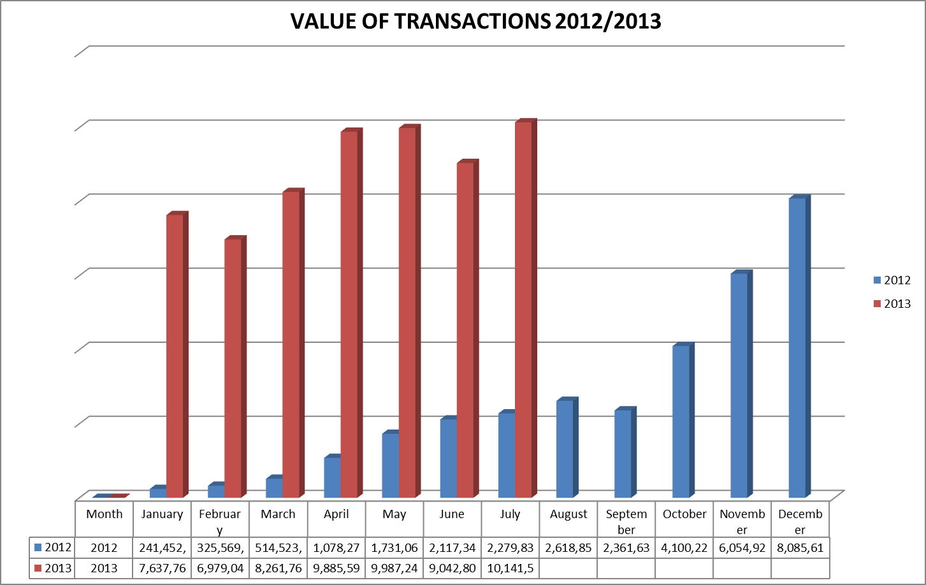
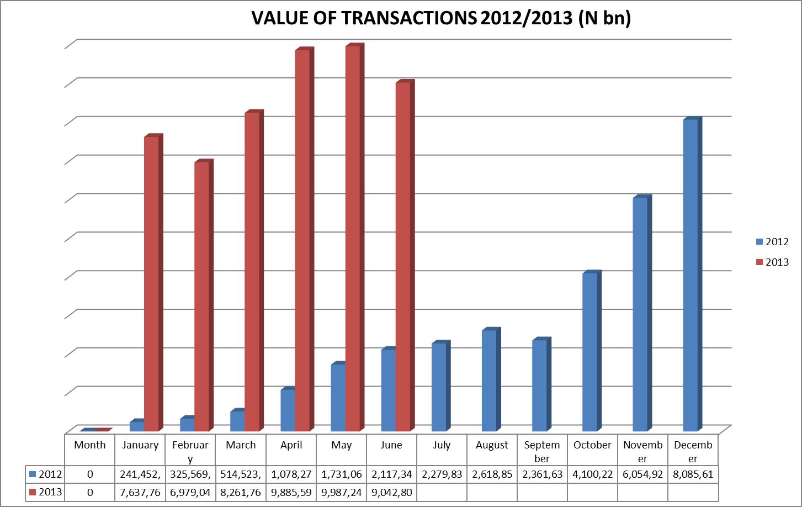
PERFORMANCE OF MMO ACTIVITIES

Slide 12
STRATEGY FOR GROWTH
Agent Network Management
Grow the agent network in rural areas
Understanding and mitigating the agent economic and business risk
Training the agents on products and customer management
Compelling Product Offering
Disbursement of inward foreign remittances
Near Field Communication enabled products and services
Linkage to bank and card accounts

Slide 13
STRATEGY FOR GROWTH
Corporate Commitment
Long term investment
Interoperability
Being able to make payments or transfer funds across different MMO.

Slide 14
TELCOS REGULATION
The Regulatory Framework (2009) for Mobile Money provides for 3 models – Bank-Led, Non Bank-Led and Bank Focused (Framework reviewed to collapse the 3 models to 2 – Bank led and Non Bank led)
Telcos excluded from leading any of the models for fears in the area of regulation, prudential supervision, monetary policy and above all, the complexity of the Nigerian economy

Slide 15
TELCOS REGULATION
However, they were assigned the following roles:
Provision of telecommunication network infrastructure
Ensure that a secure communication path is implemented
Make available, its network based on criteria which are transparent and generally applicable to all MMOs without discriminatory practices

Slide 16
TELCOS REGULATION
Ensure that its subscribers are free to use any mobile payments system of their choice
Not receive deposit from the public except in the respect of prepaid air time billing of their subscribers
Not allow the use of the prepaid airtime value loaded by their subscribers for the purpose of payment or transfer of monetary value.

Slide 17
REASONS FOR TELCO EXCLUSION
Anti- competition- It was perceived that the Telcos may have undue advantage in ruling out any form of competition against its own product through either blocking out the other players in the industry or overpricing its network access so as to give its own product undue commercial advantage.
Mobile Payments Traffic Prioritization- It was identified that the ability for a Telco to prioritize its own mobile payments system traffic over other equally sensitive payment traffic from other providers would limit confidence in the new Mobile Payments initiative as all payments traffic should be available real time.

Slide 18
REASONS FOR TELCO EXCLUSION
Systemic Risk Reduction- It was identified that the expected volume of Mobile Payments transactions in a large market as Nigeria had the potential to introduce systemic risk to the entire payments System and as such the Bank-centric models (with stringent controls) are encouraged over and above the Telco led which the CBN has little or no control over
Reconciliation issues- Reconciliation is the critical and final aspect of payments and settlements systems; the regulatory framework ensures that this problem is handled only by the traditional organizations , i.e. the Banks that have the wherewithal and experience in these areas

Slide 19
CHALLENGES OF MOBILE MONEY IN NIGERIA
As promising and exciting as the mobile money operations is, the rapid deployment and rollout of the system has been inhibited by a number of challenges. These challenges include the following:
Inadequate capital outlay on the part of the MMOs
Basic infrastructural challenges – power, telecommunications network etc.
Lack of awareness/customer education which has slowed down the adoption rate

Slide 20
CHALLENGES OF MOBILE MONEY IN NIGERIA
Lack of wide-spread agent network. Apart from being concentrated at the urban areas at the moment, they are grossly inadequate thus inhibiting financial inclusion.
Interoperability and inter connectivity yet to be fully achieved among all networks

Slide 21
WAY FORWARD
The success of the mobile money initiative is one of the catalysts that will galvanize the financial inclusion agenda of the Central Bank of Nigeria.
To this end, concerted efforts are geared towards collaborating with some relevant Regulators to make a success of the scheme. Among them are:
Nigeria Communications Commission (NCC)
-regulates the telcos
-Joint Technical Committee in place
-joint regulation of the scheme proposed

Slide 22
WAY FORWARD
Nigeria Deposit Insurance Corporation (NDIC)
-for safety of subscribers’ funds held in pool accounts at the banks
-expected to give confidence to the subscribers
National Identity Management Commission (NIMC)
-possibility of using biometrics for identification and verification of customers
-expected to address the issue of identity theft

Slide 23
WAY FORWARD
Nigeria Postal Service (NIPOST)
currently being transformed because of its wide spread and proximity to the rural areas, best suited for agent network
expected to drive financial inclusion
Nigeria Inter Bank Settlement System (NIBSS)
CBN spearheading the transformation of NIBSS as a critical enabler, by benchmarking it to SIBS International drives interoperability and inter connectivity
Enhance Financial Innovation and Access (EFInA) is the CBN development partner in the payment transformation in Nigeria

Slide 24
WAY FORWARD
Other engagements:
Constructively engaging and collaborating with the Telcos – MTN, GLO, Airtel, Etisalat
Regulatory Framework being reviewed
Agent Banking Guidelines
Building confidence through effective oversight activities

Slide 25
CONCLUSION
Even though the mobile money space is still at its infancy, fraught with a lot of teething challenges, the future looks very bright considering the huge potentials in the country.
With the collaboration of all stakeholders especially the telcos, the financial inclusion agenda of the Central Bank of Nigeria will be achieved.

Slide 26
Thank You

